Slide 1

Snake Game
AI Term Project
Guanyu Zhou
4/27/4022

Slide 2
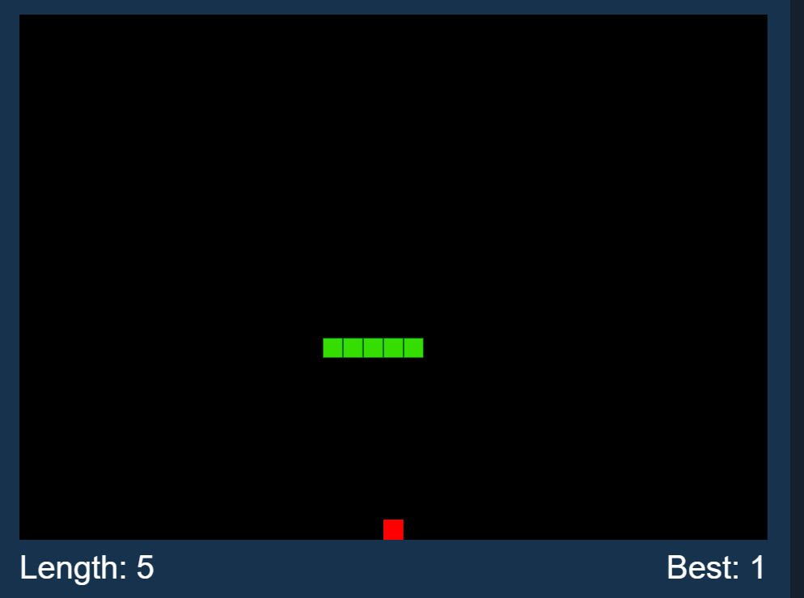
.
PyGame
Snake Game
Popular computer game with player's control.
The score is increased every time it eats the fruit.
Snake eats a fruit, and it grows in its size.
Lose Condition:
1: The snake crashes into the wall
2: The snake head crashes into its own body

Slide 3
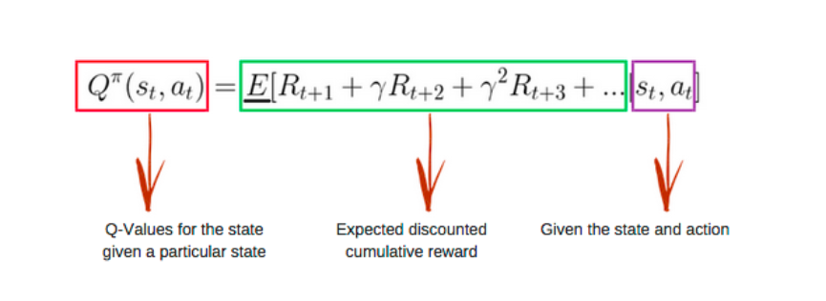
Objective
https://www.ypppt.com/
Apply Reinforcement Learning
ON
SnakeGame

Slide 4
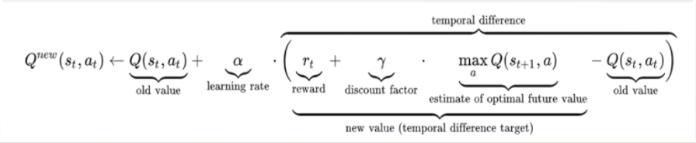
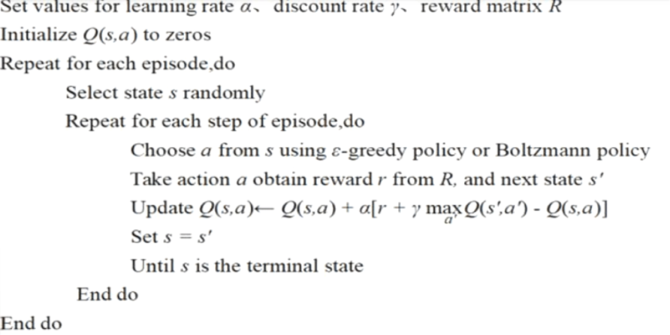
Q Learning
https://www.ypppt.com/
Observation of the environment
Deciding how to act using some strategy
Acting accordingly
Receiving a reward or penalty
Learning from the experiences and refining our strategy
Iterate until an optimal strategy is found
标题文内容
标题文字内容
ENTER THE TITLE HERE

Slide 5
Implementing q-learning(parameters)
Q values of all states initializing
Gamma
Learning rate
0
0.80
0.05
[ ]
1/-1
0.1
Storing all states history
Reward
Exploring
July, 20XX

Slide 6
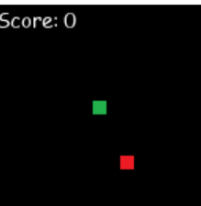
Implementing q-learning(REWARD TABLE)
Snake(Green) will start in the middle of the game window with default direction right until it eats the red dot/dies
-1.0, Negative Reward: Snake dies（hitting wall/tail）
-0.1, Negative Reward: Snake not die or eats the apple
(Reward is negative so that it will "encourage" the snake to move towards to the red dot target)
+1.0, Positive Reward: Snake eats red dot
July, 20XX

Slide 7
IMPLEMENTING Q-LEARNING(IN/OUTPUT)
Input (Movement Offline)
Output
is wall/tail directly up front
is wall/tail directly on the right side
is wall/tail directly on the left side
is snack ahead (no matter how far)
is snack on the right (no matter how far)
is snack on the left (no matter how far)
1
Do Nothing (keep going on current direction)
2
Turn right
3
Turn left

Slide 8
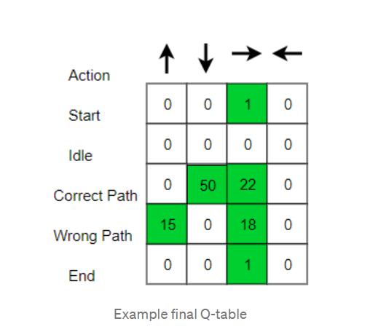
IMPLEMENTING Q-LEARNING(EXPLANATION)
The Q matrix is filled with 0 at the start.
The Q table updated every time that the agent makes the move as below:
Q[state, action] = reward + gamma * max(Q[new_state, :])
Output
During the training phase, the agent will choose either max Q value
or a random action.
The process is iterated until the game is finished.
The Q matrix is updated with total games that have played.

Slide 9
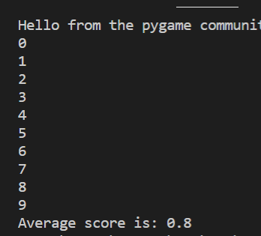
Result
https://www.ypppt.com/
The eventual outcomes is that the agent is following shortest path towards goal after training using the most updated Q table.
标题文内容
标题文字内容
ENTER THE TITLE HERE

Slide 10
Scaling Scores by q learning
Result
IF WE PLAY MORE games
We will have Long Long Tail Snake With High Scores

Slide 11
Reference:
LearnSnake: Teaching an AI to play Snake using Reinforcement Learning (Q-Learning): https://italolelis.com/snake
Simple Reinforcement Learning: Q-learning: https://towardsdatascience.com/simple-reinforcement-learning-q-learning-fcddc4b6fe56

Slide 12
THANKS

